Slide 1

Branch Diver Lectures

Slide 2
Version History – hidden slide
Version | Date | Who | What changed
2.0 | Sep06 | HQ | Released as Version Sport Diver Lecture 10 - Open water diving and dive procedure.
3.0 | Apr14 | Alastair McCulloch | Updated to reflect new Training Schedule with addition of Branch Diver Grade. Lecture renumbered as BDL7 to match the new syllabus. SSAC changed to ScotSAC throughout. Added hidden version history slide. Email address for feedback added to closing slide. Added footers with Lecture number and Page number to slides.

Slide 3
Lecture BDL7
Open Water Diving
and Dive Procedure

Slide 4
Overview
Preparing for your first dive
Key personnel
Pre Dive Planning
Risk Assessment
Equipment
On site brief
Kitting up and Buddy checks
Separation procedure
Entry / Exit points
Surfacing
Debriefing

Slide 5
Preparing for your first dive
Your first open water dive is a milestone in your diving career - a good dive and you’re hooked for life
If you have a bad dive, you may not be able to dive again or be able to go back in the water for many months
Your first dive must be easy, safe, enjoyable and send you away on a high
First dive should be fun – no assessments

Slide 6
Key Personnel
Expedition Leader - Appoint officers on the day as below
Dive Marshall - In charge of diving area that day
Safety Officers - Close watch on diving & standby diver
First Aid Officer - Self-explanatory & properly equipped
Equipment Officer - Equipment is serviceable & A flag
Dive Leaders - Responsible for the briefing of their divers and safety in water. Should ensure safe entry and exit from water Lead dive safely ensuring group fin at speed of slowest diver
Note: The same person my perform multiple roles

Slide 7
Good Conduct
Many dive sites are open to the public: that includes children - so your dress code and language could bring you or your Branch of the Scottish Sub-Aqua Club into Disrepute
Treat others as you would like to be treated
Always leave dive sites clean and tidy
Whenever possible try to help others with problems (e.g. spare hoses, fin clips - you don’t know when you may need a helping hand yourself)
Share your local knowledge with others

Slide 8
Pre-dive planning
Choice of site will be determined by many issues including:-
  Access to site
  Experience of divers
  Weather and Tides
  Equipment
Dive groupings should be decided and key personnel appointed
Details of the site should be discussed:
  Depth, bottom terrain, tidal influences, dive time, anticipated visibility, exit and entry points, other hazards etc.
The current weather conditions are taken into consideration: this may cause a major change to the intended diving and necessitate the usage of an alternative dive plan.

Slide 9
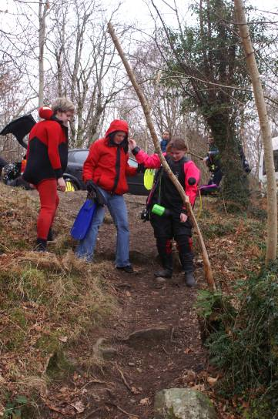
Risk Assessment
A risk assessment should be performed before every dive
Points to consider include:
  Safety of entry / exit points
  Changeable tides / weather
  Experience of divers
  Air consumption
  Refer to ScotSAC Health and Safety Manual for further information
Full details of location, nearest telephone, hospital and recompression chamber should be recorded

Slide 10
Personal Equipment
Protective equipment: Drysuit/wetsuit, boots, gloves, hood, swim trunks or swimsuit, undersuit
Basic Equipment: Mask, snorkel, fins
Safety Equipment: BCD, knife, weightbelt, depth gauge, watch, computer
Breathing Equipment: Cylinder(s), Demand Valve(s), contents gauge(s)
Ancillary Equipment: Surface Marker Buoy (SMB), compass, torch etc. (as required)
Spares
All equipment should be in good working order

Slide 11
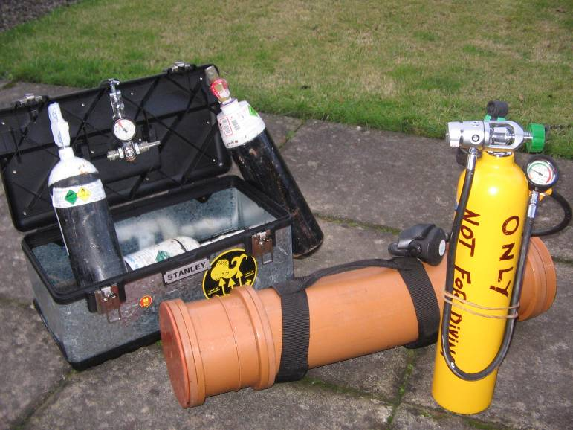
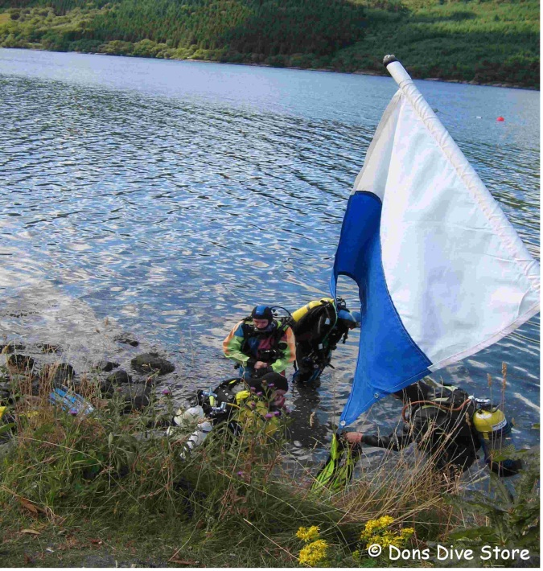
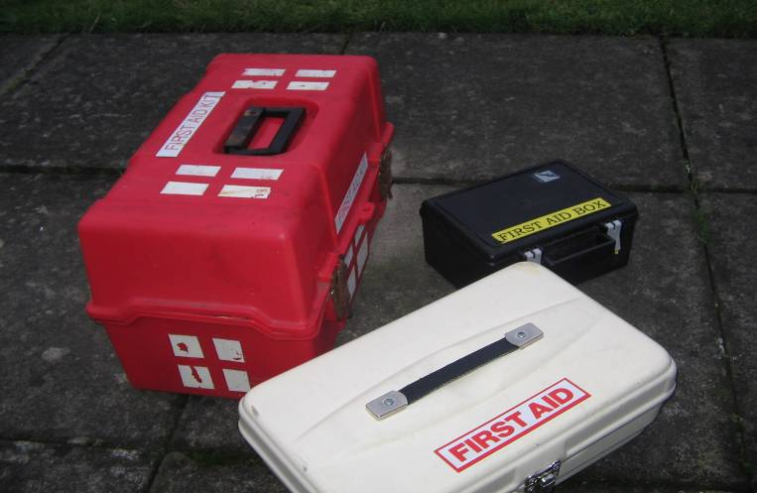
On site equipment
Oxygen Kit
First Aid Kit
‘A’-Flag
Phone or other form of communication

Slide 12
On site Briefing
Site description
  Description of seabed
  Currents / tides
  Likely visibility
  Obstructions
Dive pairings
Dive plan
  Depth
  Time
  Assessments?
Entry / exit risks

Slide 13
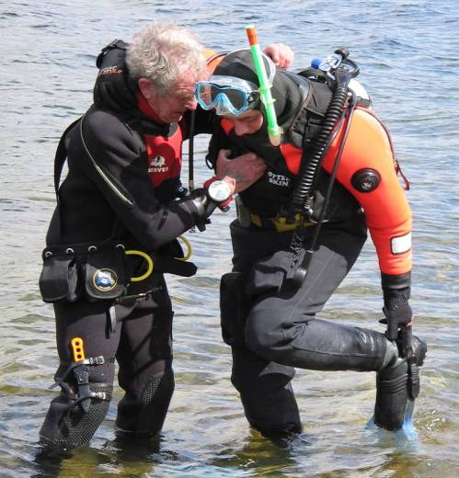
Kitting up
Donning suit
Assembling equipment
Assisting buddy
  Lifting tank
  Fitting fins
© Dons Dive Store

Slide 14
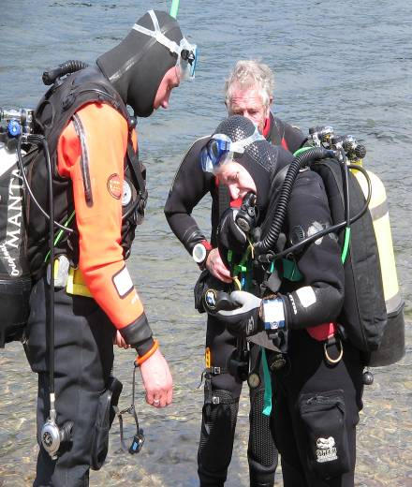
Buddy Checks
Must be carried out before each dive
SEEDS:
SAFETY, separation and emergency procedures
EXERCISE: dive purpose
EQUIPMENT: air contents check/ABLJ/STAB operation/drysuit (if worn) operation and valve type/ instruments/ weightbelt release.
DISCIPLINE: relative position of dive leader and buddy/specific duties.
SIGNALS: signals to be used during dive/at surface/ in low visibility

Slide 15
Action If Separated
Plan the dive and dive the plan
Turn around slowly looking in all directions for buddy
Visual and audible signals – torch, tank tap etc
If no contact ascend to surface at a normal ascent rate
Signal to shore / boat cover
Look for buddy on surface – signs of bubbles / flat spot
DO NOT descend – even if you see their bubbles – mark spot and communicate to standby diver
Separation procedure should be agreed between divers during the dive briefing

Slide 16
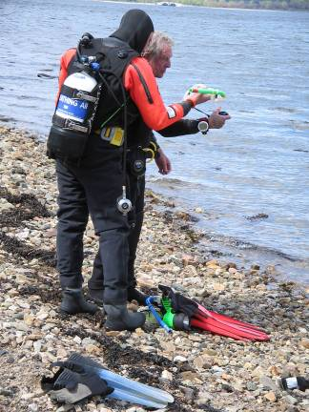
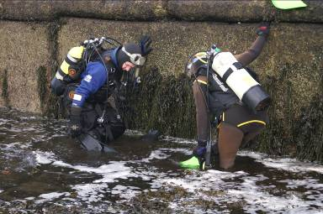
Entry & Exit: Shore
Slip Hazards
Easily recognisable exit point
Shore cover
© Dons Dive Store

Slide 17
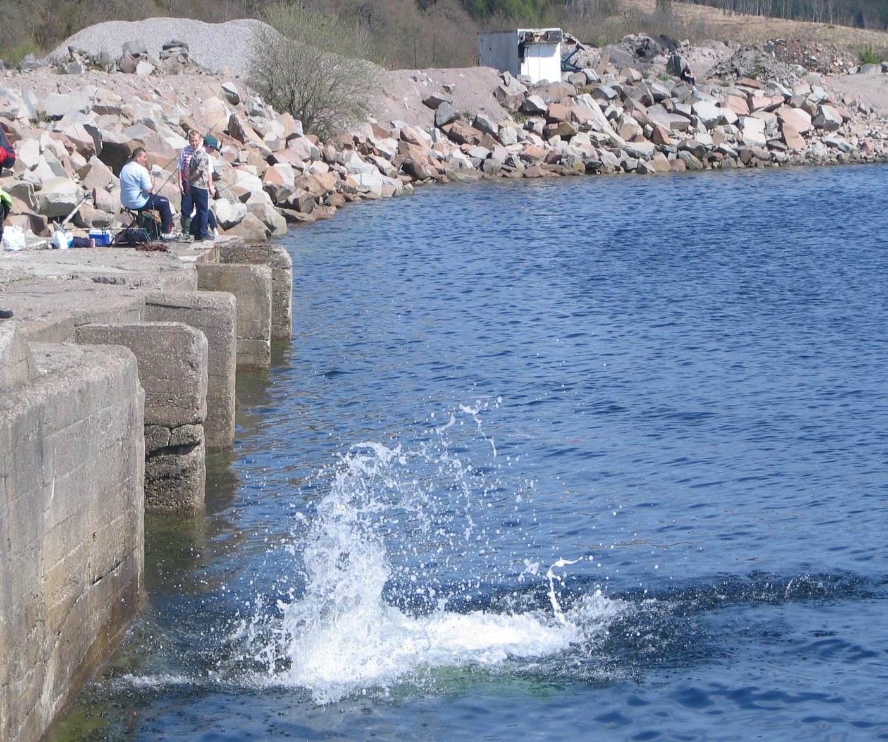
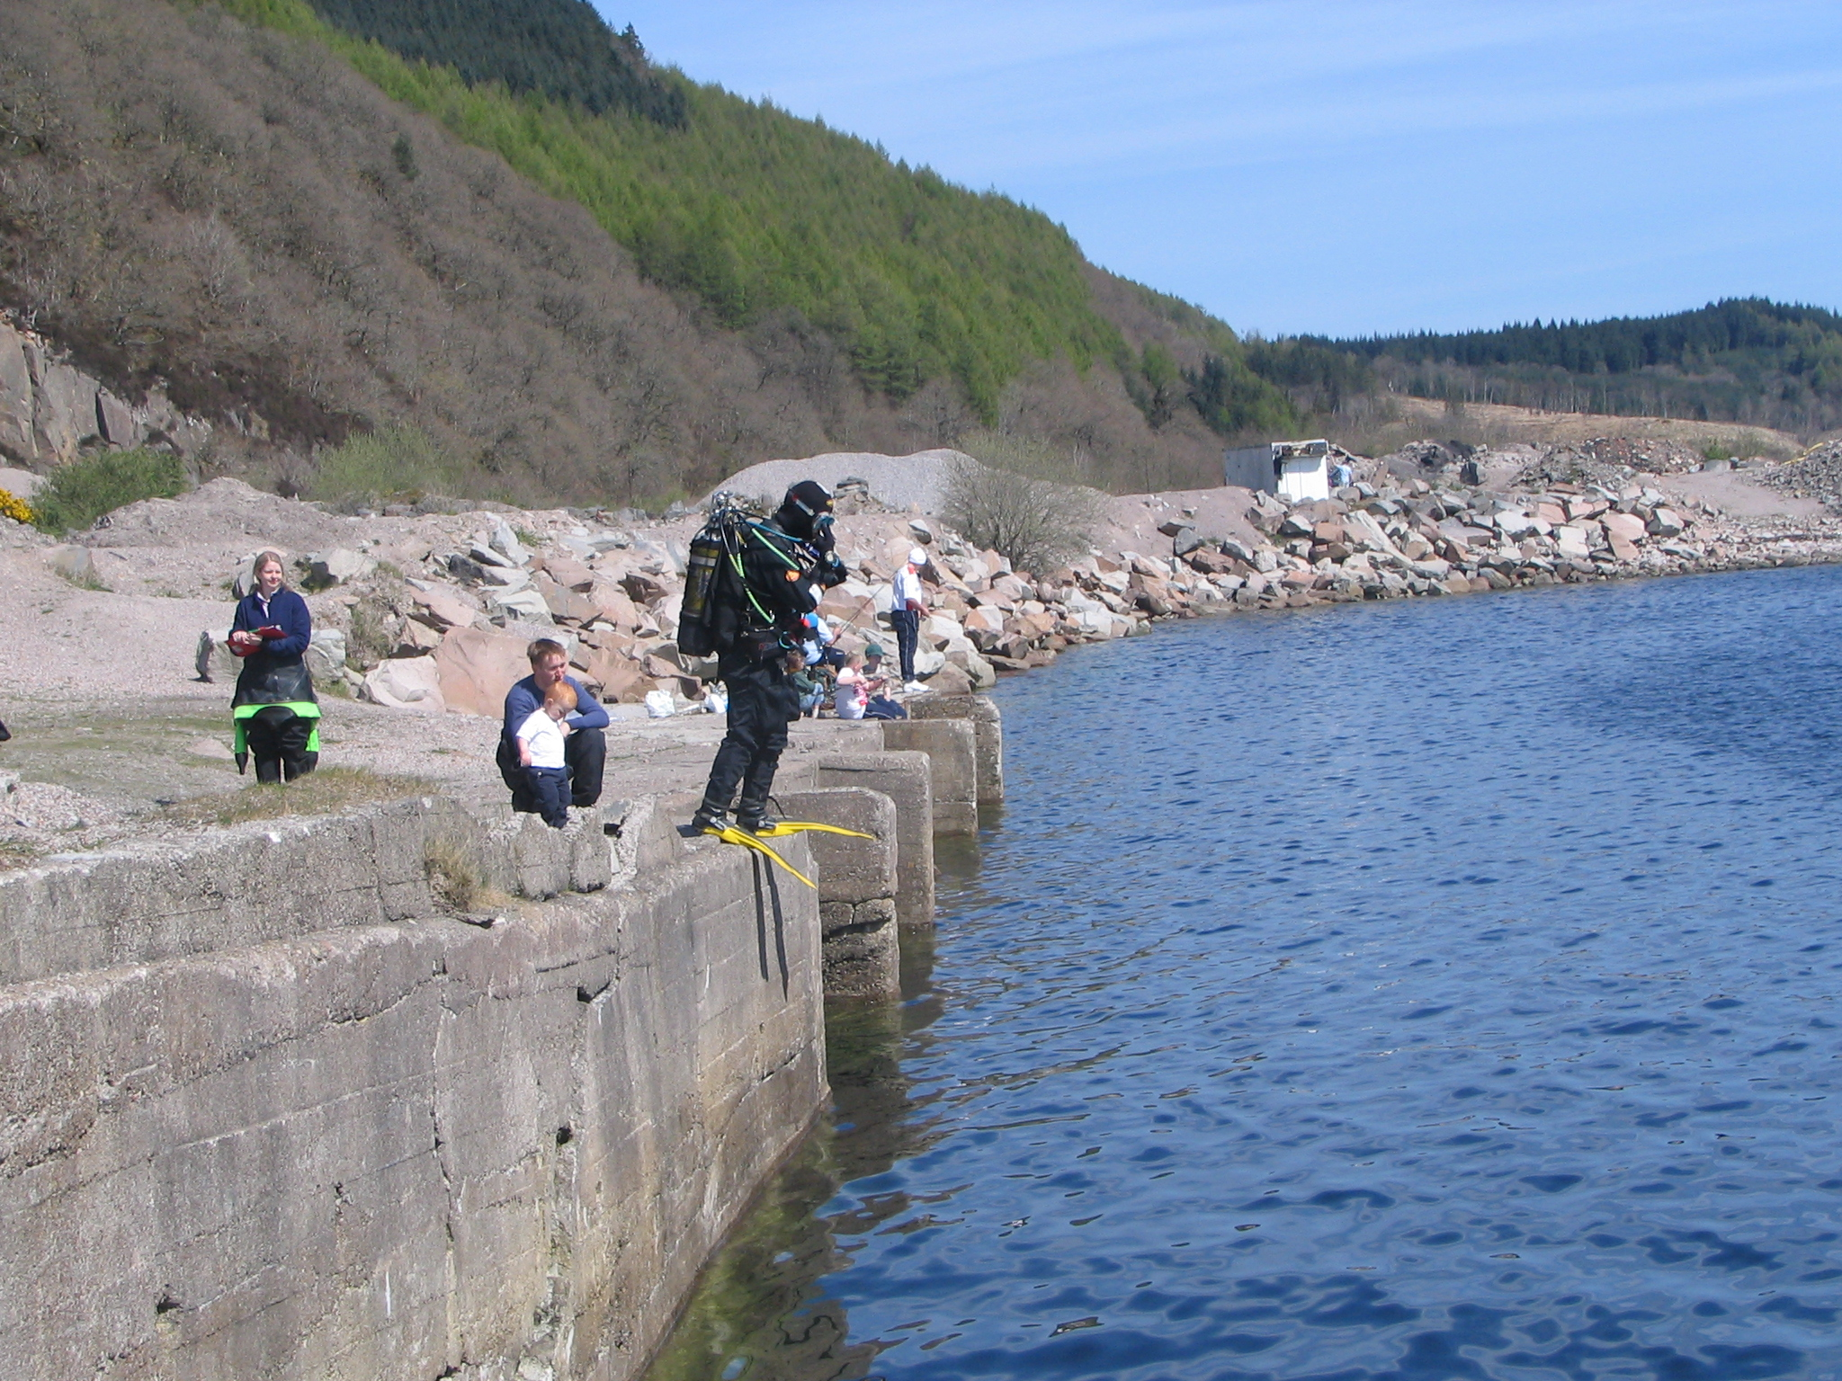
Entry from height
Safe exit point?
Shore cover
Underwater obstructions
Secure all equipment
Hold mask & DV
All clear below
OK signal

Slide 18
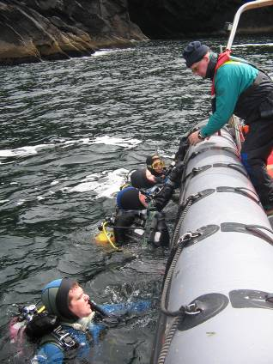
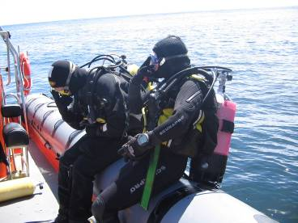
Entry & Exit: RHIB
Launch & recover of RHIB
Kitting up
Entry – backwards roll
Exit – dekitting & re entry into RHIB

Slide 19
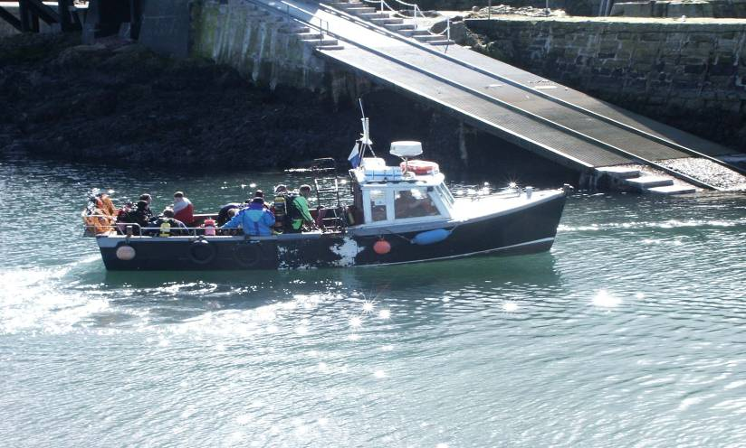
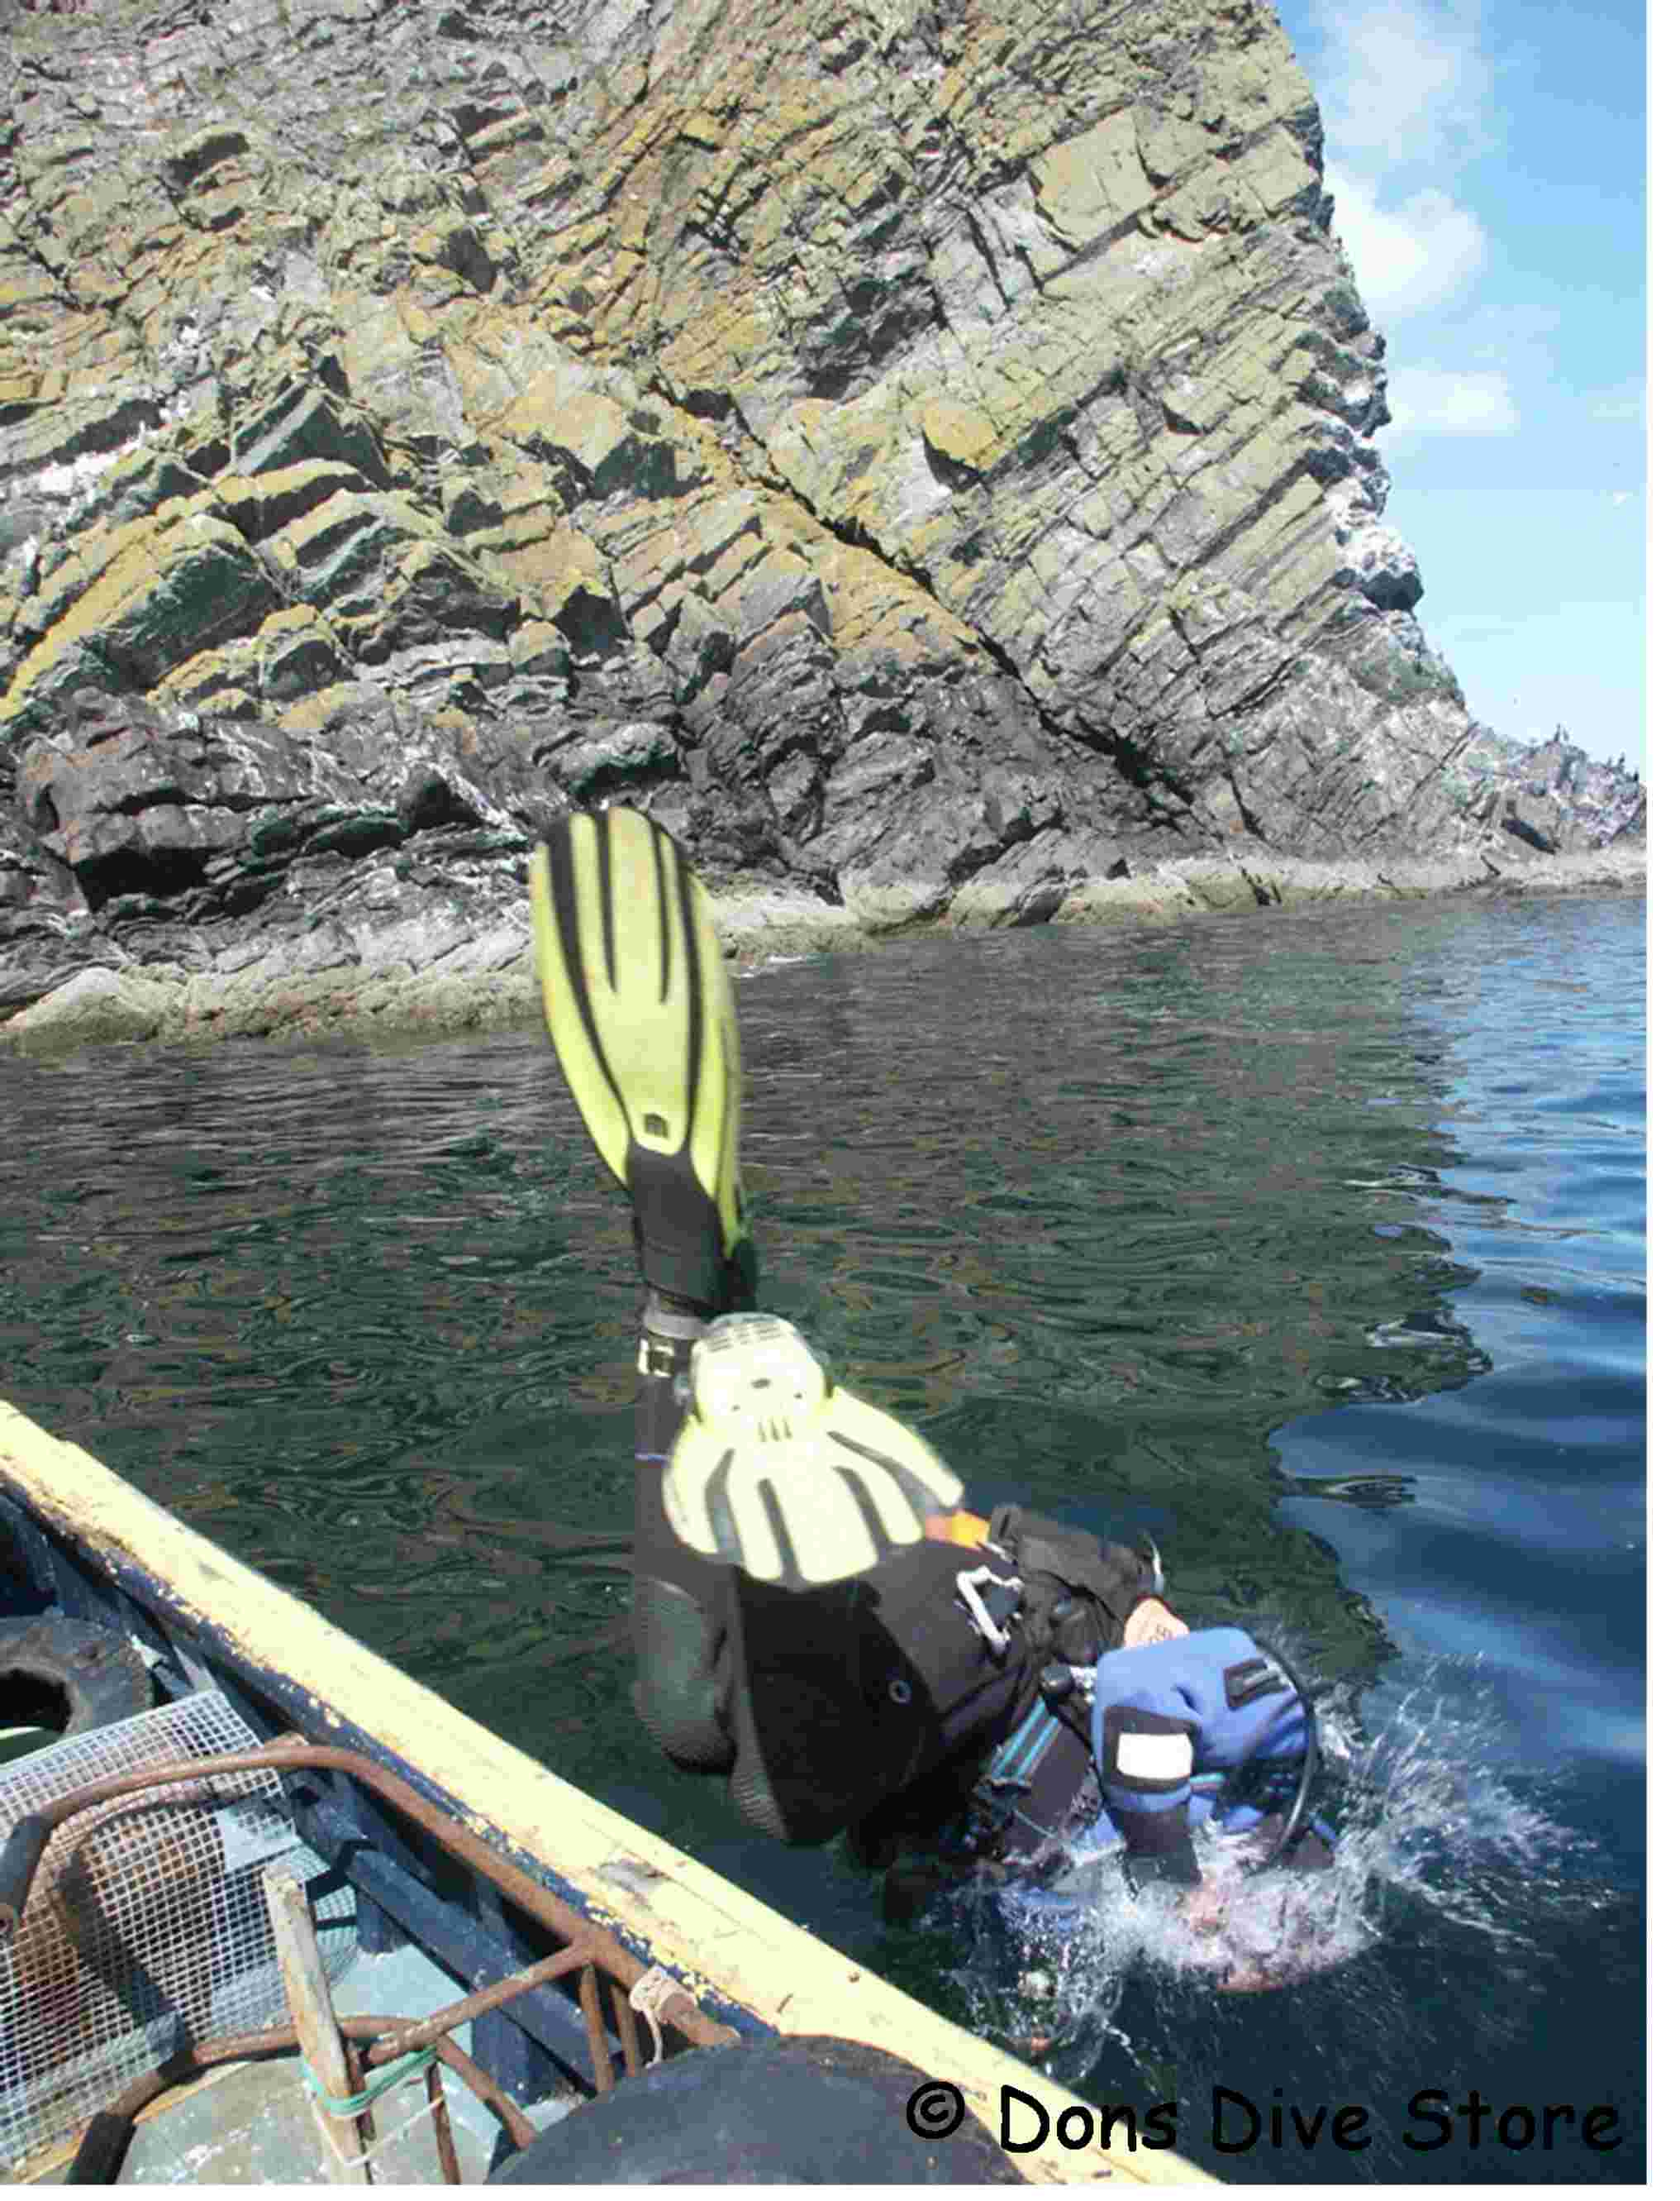
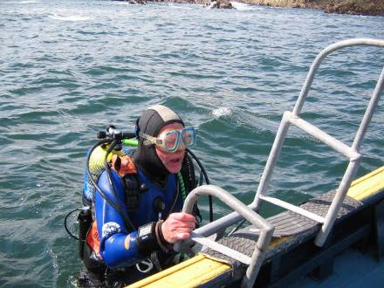
Entry & Exit: Hardboat
Kitting up
Entry – roll or jump
Exit – ladder
Fins on or off?
Kit on or off?
© Dons Dive Store

Slide 20
Surfacing Drill
The “go up” signal must be exchanged with all the divers
During the ascent face your buddy and check rate of ascent
Remember to breathe normally at all times
Control buoyancy
Always carry out required decompression / safety stops
As you approach surface hold hand above head, turning 360º and watching for obstacles such as boats
Repeat 360º turn on surfacing, being ready to take evasive action
Exchange the “ok” signal with your buddy and keep close
Inflate you BC jacket, signal to your shore/boat cover then move off

Slide 21
Abandoning Dive
Ending a dive is not wrong, or poor dive planning. It is often necessary
Abandoning a dive may save a life
So at what point do you or the dive leader stop the dive?
  Bad weather
  Poor sea conditions
  Poor visibility
  Low on air
  Equipment problems
  Diver problems
How would you cope with the following scenarios?
  Your tank falls out of your B.C.
  You loose a fin
  You loose your weightbelt
  DV begins to leak / freeflow
  Mask continually flooding

Slide 22
Debriefing
Briefing and action of dive leader
Frequency of checks
Simple underwater navigation
Check on use of air
Reason for finishing a dive
Surfacing
Coming ashore or entry to a boat
Debriefing and dive record
Be aware of any signs or symptoms of diving illnesses

Slide 23
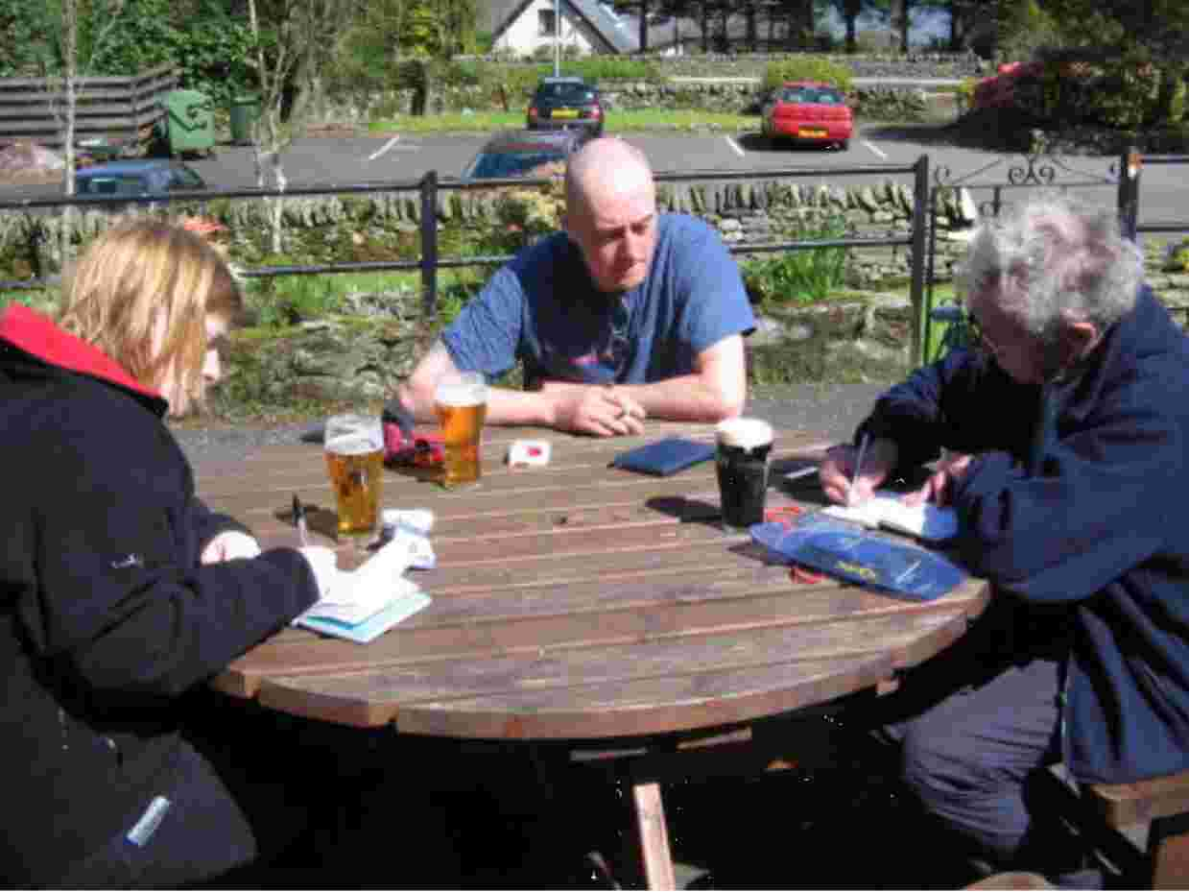
Logbooks & Debriefing
Fill out your log book
Make sure all
participants in dive sign
it
Keep training record up
to date

Slide 24
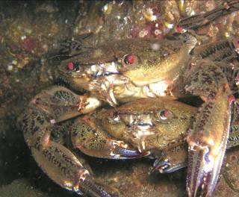
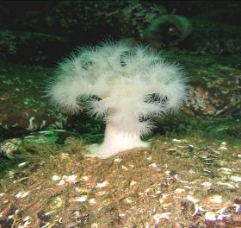
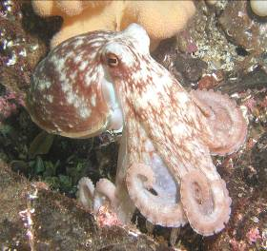
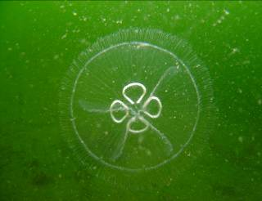
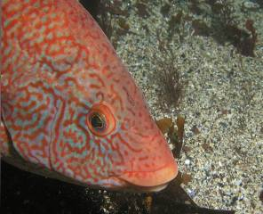
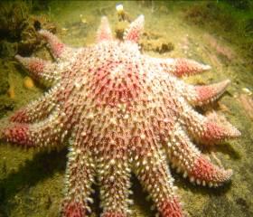
What do you see?
© Don’s Dive Store

Slide 25
Summary
Safety
Dive planning
Preparing to dive
Conduct: on-site & in-water
In-water procedure
Entry & exit procedures
After the dive

Slide 26
The End
Thank you for your attention
Any questions?

Slide 27
Please provide any feedback on these slides to hq@scotsac.com
Thanks.

